Slide 1
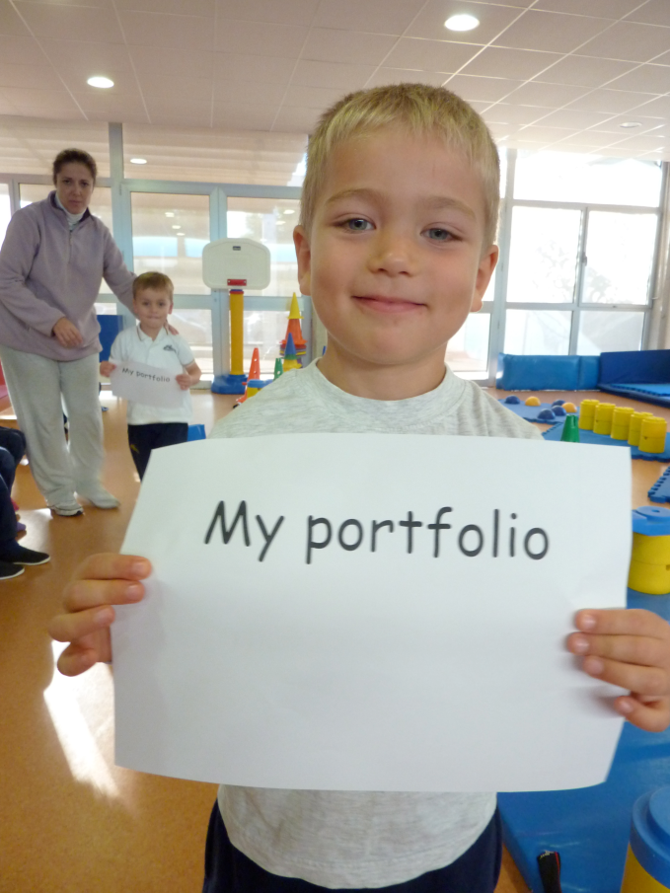
Portfolios in the Nursery Cycle of the European Schools
Lisa Melessaccio, ES Munich
http://www.schola-europaea.eu/ELC/en/docs.html

Slide 2
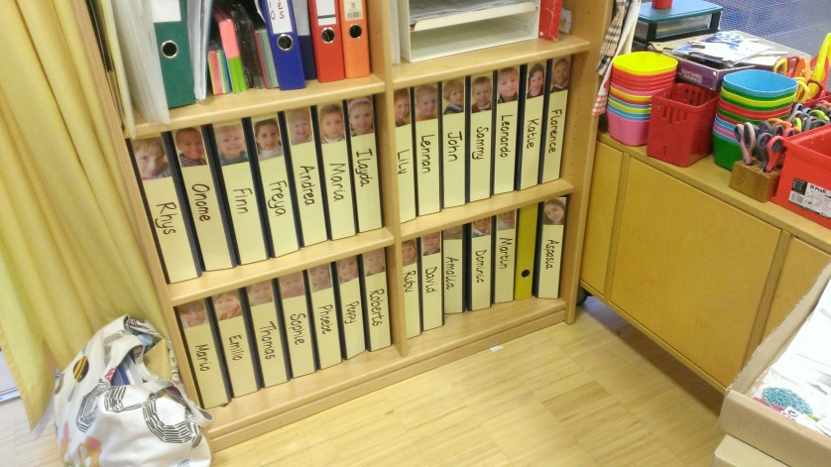
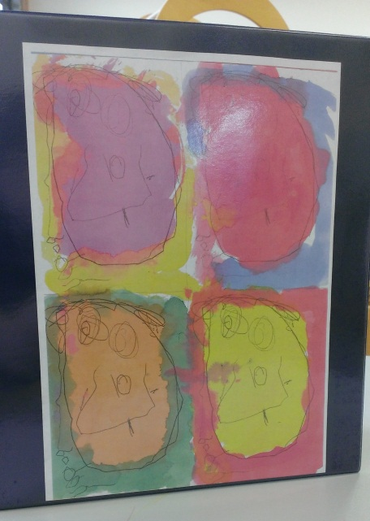
What does a portfolio look like?

Slide 3
How do we structure a portfolio?

Slide 4
Structure of the Portfolio
Biography: Who am I? I am … I come from … I live in …
I like … I have a family … My friends are …
Collection of the child´s work: 4 areas to reflect the growth of the child´s physical, social, emotional, cognitive and creative development
Self-evaluation part

Slide 5
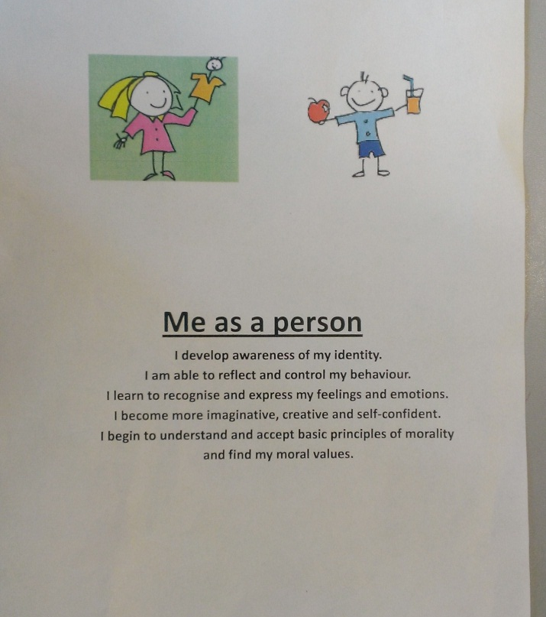
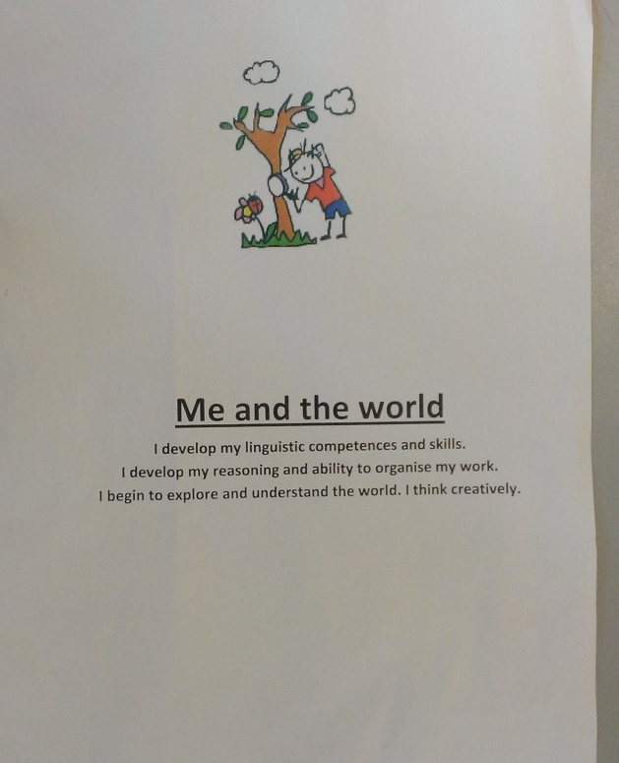
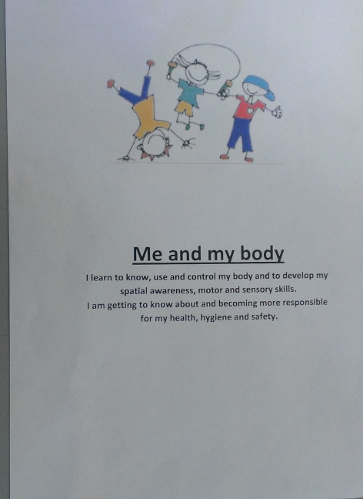

Slide 6
Me as a person
I develop awareness of my identity.
I am able to reflect and control my behaviour.
I learn to recognise and express my feelings and emotions.
I become more imaginative, creative and self-confident.
I begin to understand and accept basic principles of morality and find my moral values.
At the start of the year children start to work on their biography.

Slide 7
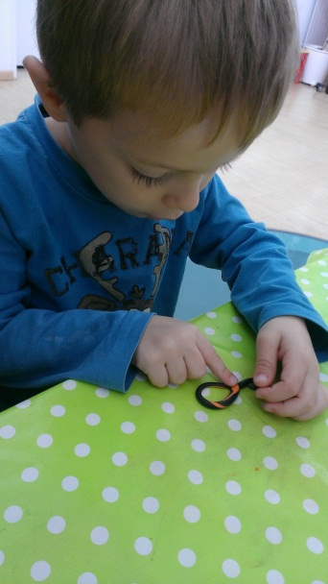
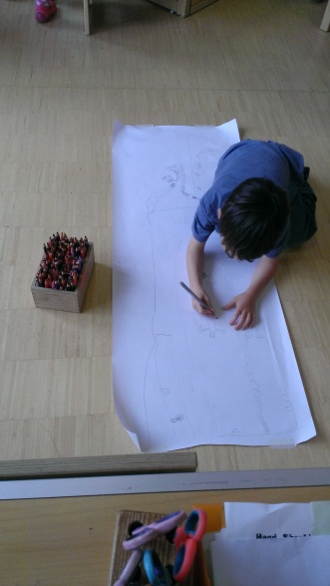
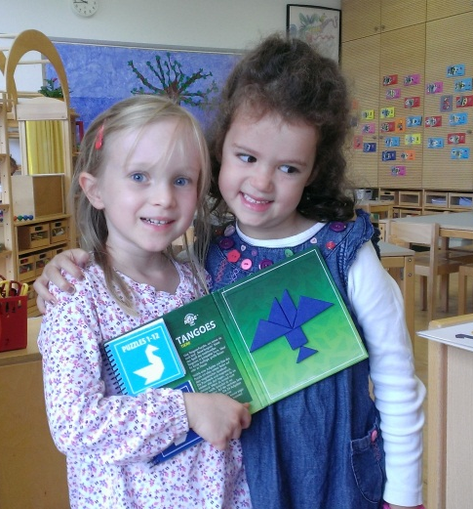
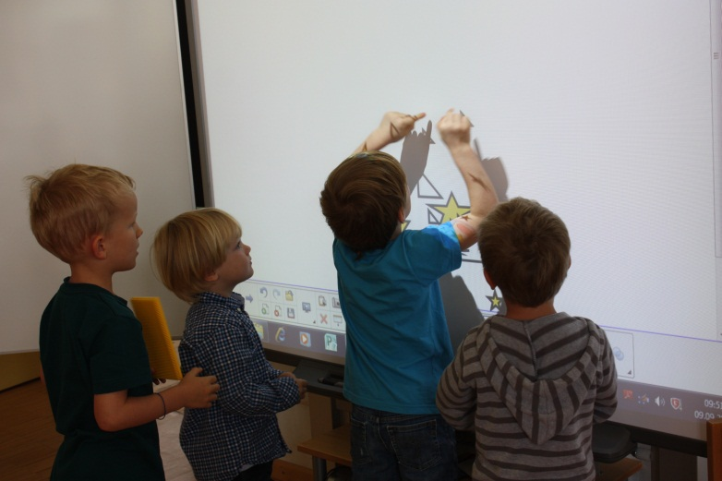
Include photos of model building, sorting and to record play activities

Slide 8
Paintings and drawings which are too big to include in a folder can be photographed

Slide 9
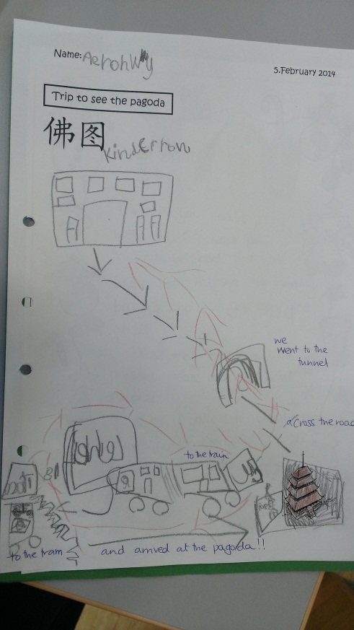
Date every piece of work!
Recording a culmination of a project on Chinese New Year.

Slide 10
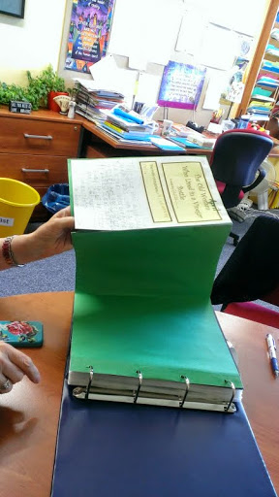
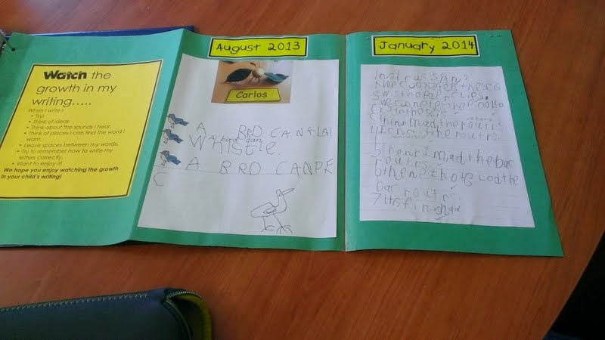
An effective and visual way to show progression or not.

Slide 11
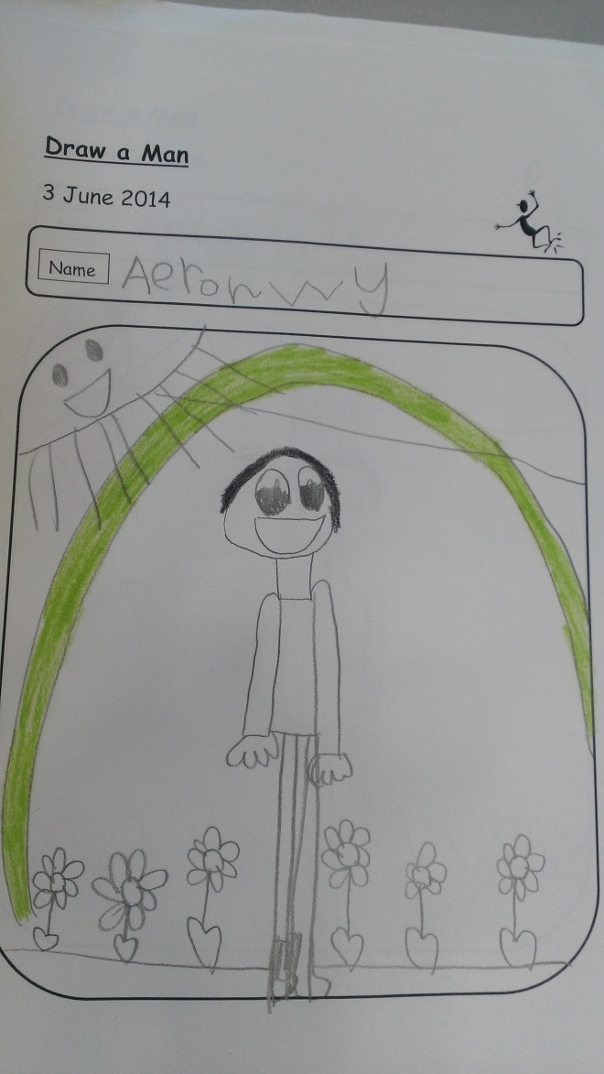
A self-portrait is an activity repeated several times. This shows development and progress.

Slide 12
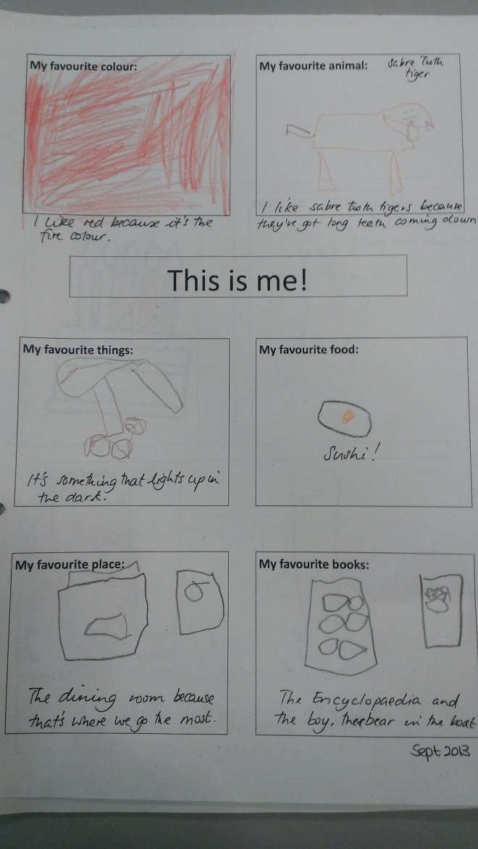
My favourite colour, favourite animal, favourite friend, favourite game, what I like to do, what I like to eat, my favourite story, something I wish for!

Slide 13
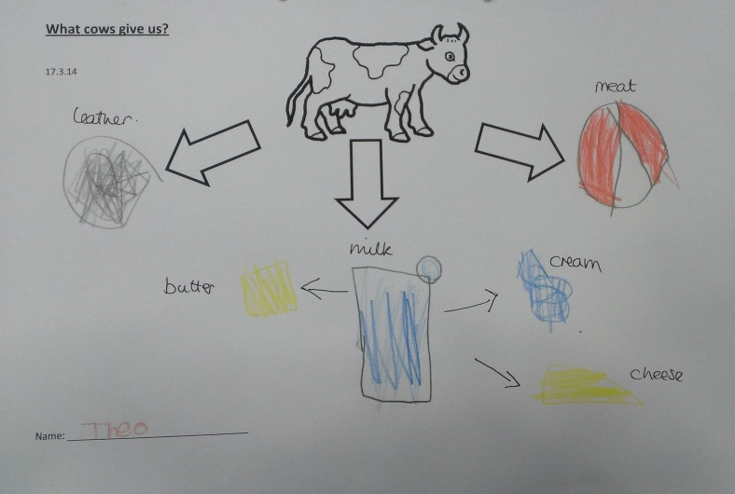
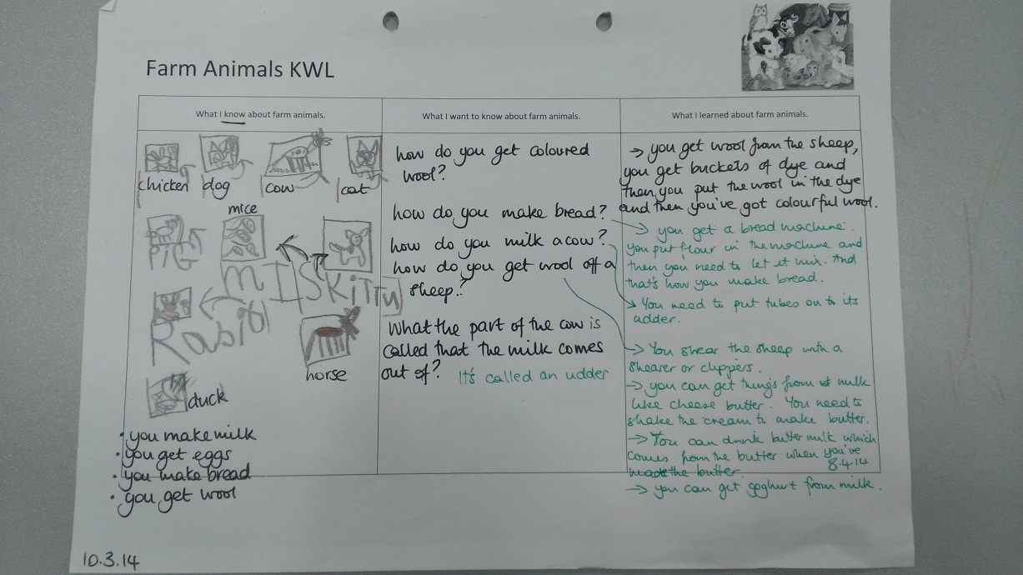
KWL

Slide 14
A treasure chest can be used by children to collect their work.
How will this be managed?
This is the next challenge in the nursery.
To deepen the child's ownership of the portfolio.

Slide 15
Self evaluation
My feedback…..

Slide 16
Stickers can be created to reflect different self-assessments.

Slide 17
?
Sharing portfolios with parents.

Slide 18
PORTFOLIO EARLY EDUCATION CURRICULUM
APPROVED BY THE JOINT TEACHING COMMITTEE ON 9, 10 and 11 FEBRUARY 2011 IN BRUSSELS
For the child | For the teacher | For the parents
To build positive self-esteem | To highlight success | To celebrate
To develop awareness of his/her identity | To help the child develop his/her identity | To reflect family stories, culture and languages
To develop awareness of the point of view of others | To help the child discuss what to include and exclude | To talk about the choices made.
To develop awareness of what he/she likes | To encourage and feed interests and passions and to help discover new interests | To recognise and discuss the child's interests and preferences.
To stimulate thinking and awareness of what he/she knows and can do | To help the child to identify and use his/her knowledge and learn new things. To help consolidate and refine knowledge and abilities | To be aware of the child's knowledge and abilities
To reflect on his/her progress : self-assessment | To encourage reflectiveness and a positive attitude which favours progress. | To encourage and support

Slide 19
Meetings
A powerful way of sharing information about children's development
Based on the record of the children's development and on the portfolio
Organised at least twice a year
If possible, the child participates

