Slide 1
Thinking about talking and listening in the Early Education Curriculum
Nicholas Moon

Slide 2
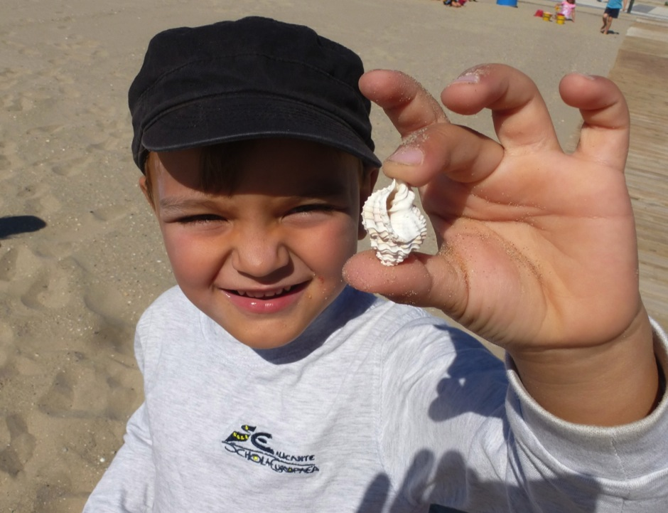
Children talking
They want to communicate

Slide 3
Talking in the EEC

Slide 4
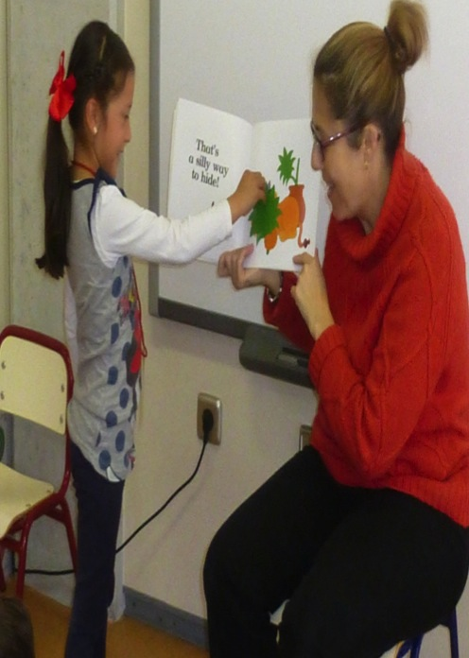
Talking to children

Slide 5
Children listening

Slide 6
“Explaining, describing ,communicating something novel to others, giving an opinion, talking about feelings…”

Slide 7
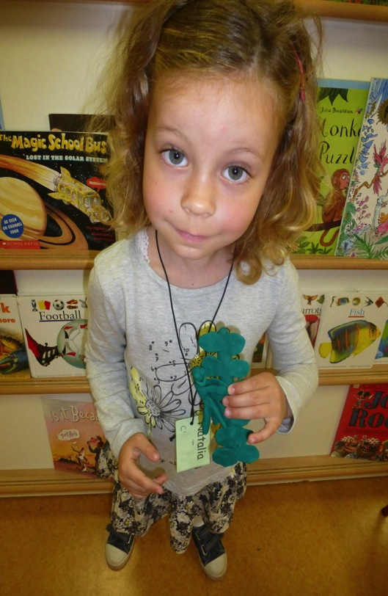
Show and Tell
An opportunity for children to talk about specific topics.
A chance for children to question the speaker.
A presentation which may or may not be supported by other material eg photos, drawings, objects.

Slide 8
Other topics include: My Dad, My Mum, Something I am good at, and, Free Choice.

Slide 9
Easi-Speak a simple microphone/recorder

Slide 10
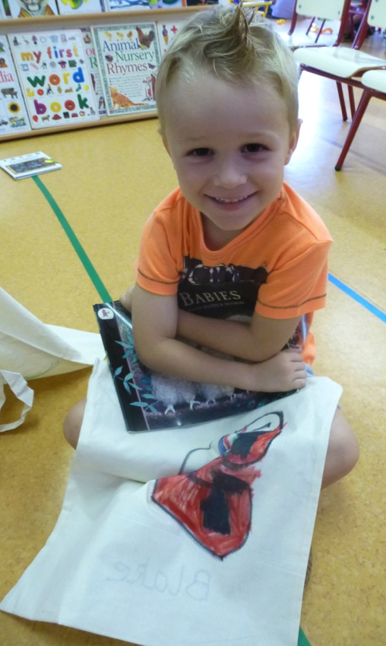
I know 10 parts of my body!
Blake made a numbered list of parts of his body.

Slide 11
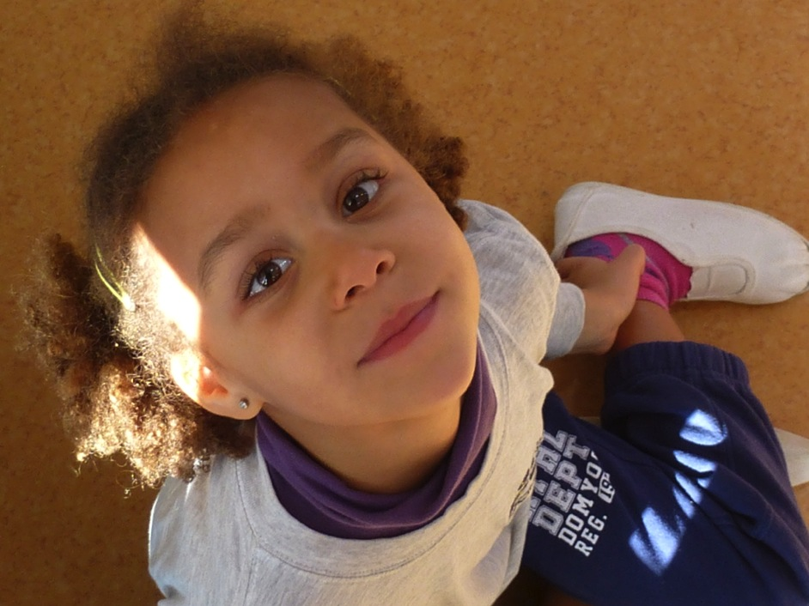
My favourite breakfast!
Keyla cut out cereal boxes and stuck them on card, then she drew pictures too!

Slide 12
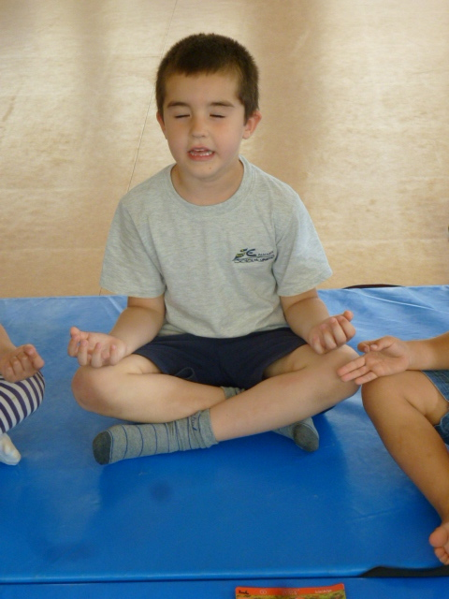
Something I am good at
Alex spoke about helping look after his baby sister Mara. He made a list…

