Slide 1
Portfolio in the nursery
Used tools examples
Experimentation of a self-assessment system
I
Nathalie José, ES Luxembourg

Slide 2
Variety of tools used in class to fill the student’s portfolio.
Part 1: Life notebook
Link between school and family
The teacher and the child can put the poems, songs and nursery rhymes seen during class, the narration of a story worked in class, the chronology of a school day…
We can equally insert photos of different important moments like the Christmas choral, a day out to the museum, the scientific week in school, a child’s birthday…
Every 15 days, the notebook is sent at home for the week-end, the parents can therefore discover what is done in class. They also can stick photos in it, various documents, drawings, write texts which will permit the child to explain in class what he has done with his family.

Slide 3
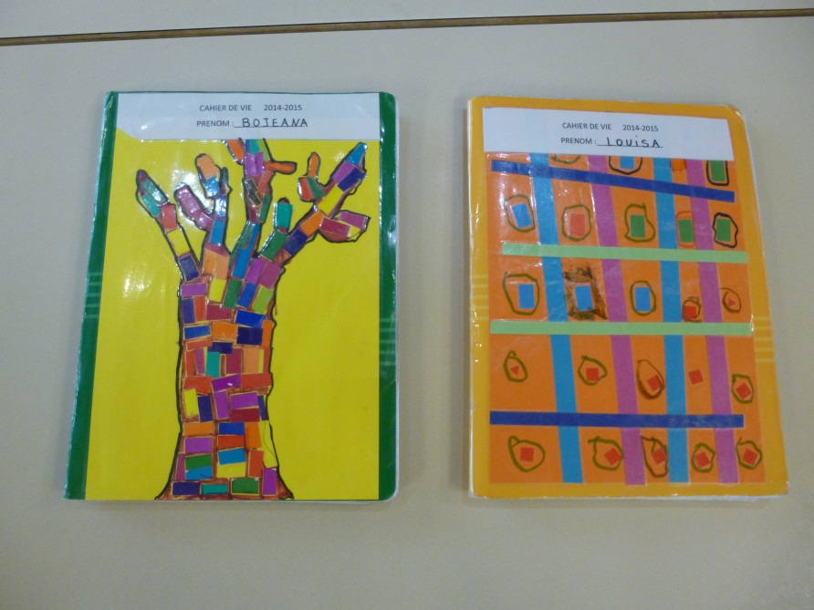
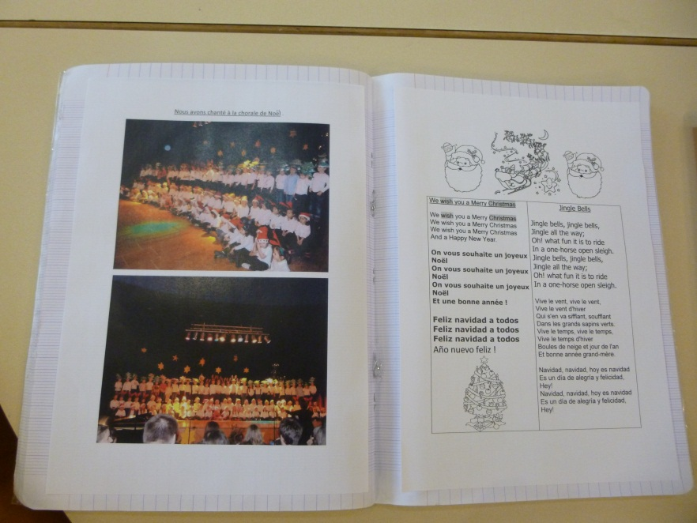
Examples: documents stuck in the life notebook
Life Notebook Nursery 1 and 2
Christmas choral and Christmas songs

Slide 4
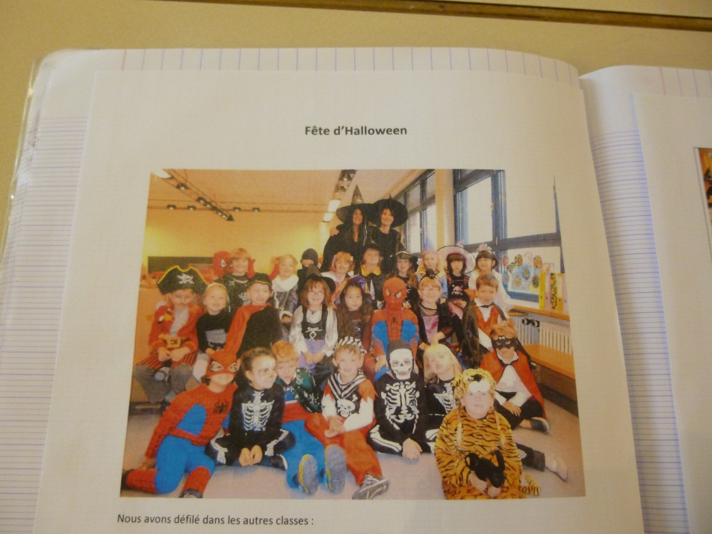
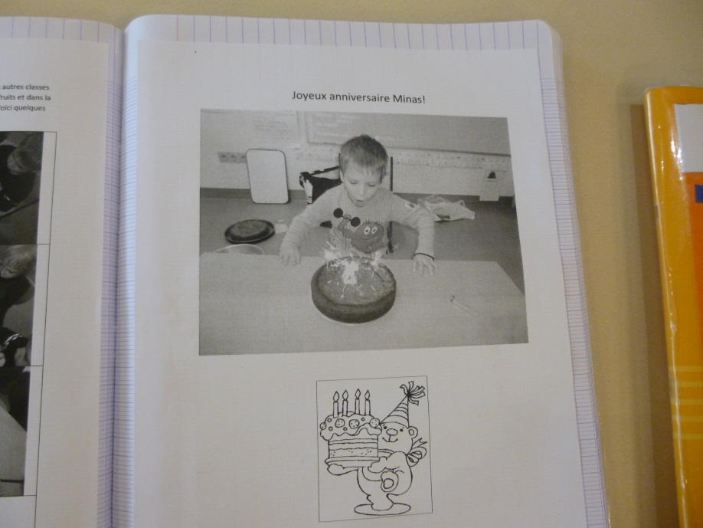
Life notebook
The Halloween Party
The Birthdays

Slide 5
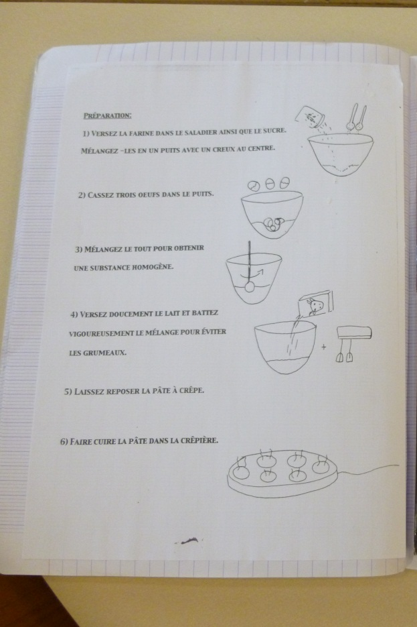
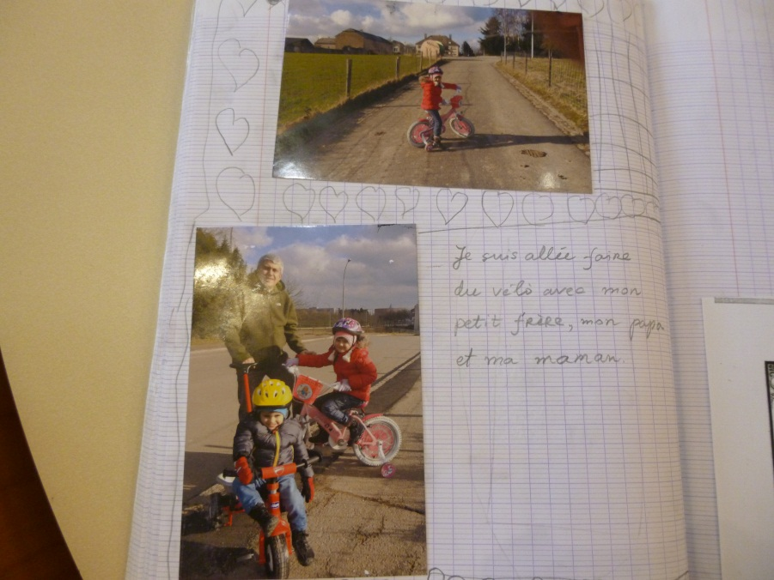
Life notebook
The recipe for creps
The Child’s photographies, riding his bike with his family.

Slide 6

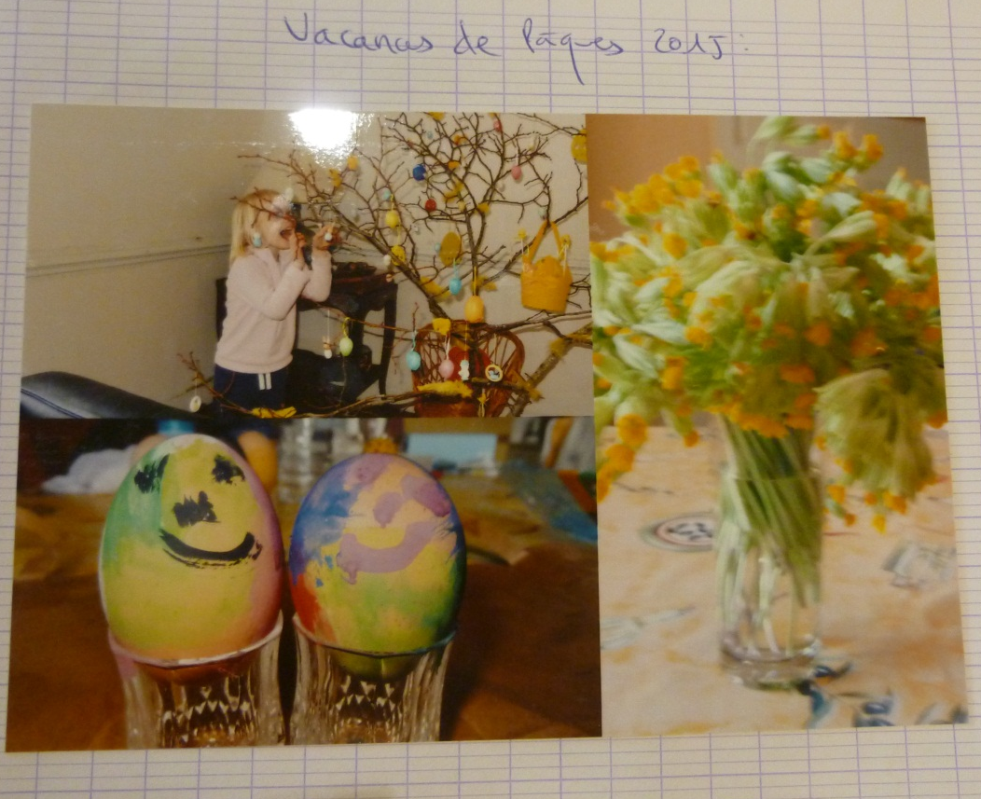
Life notebook
Drawings of a little girl near her house
Easter Holidays in France

Slide 7
PART 2: The success notebook

Slide 8
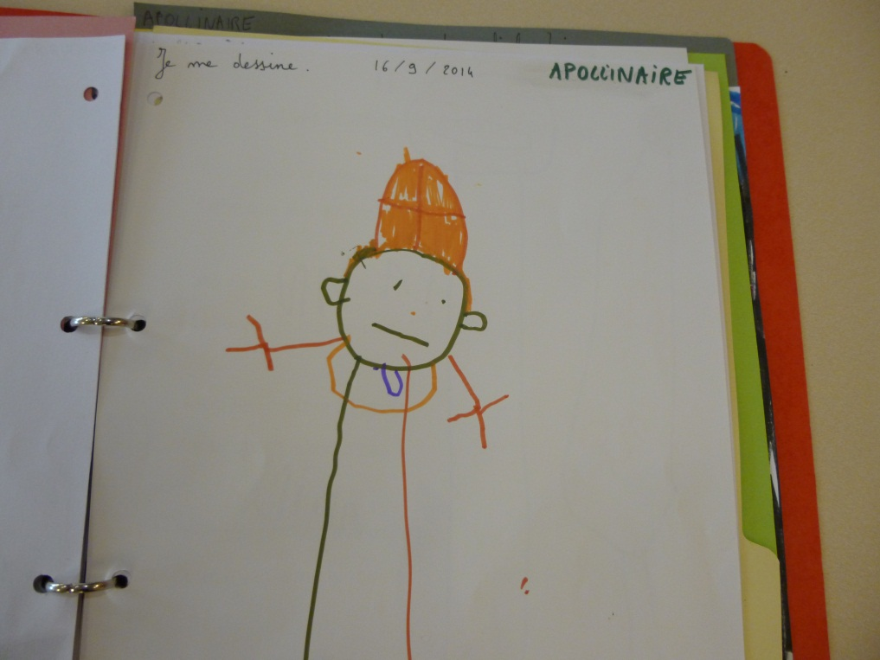
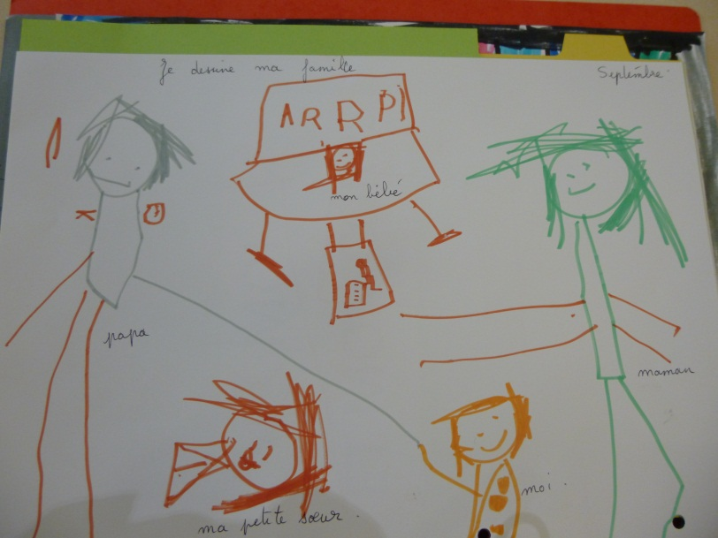
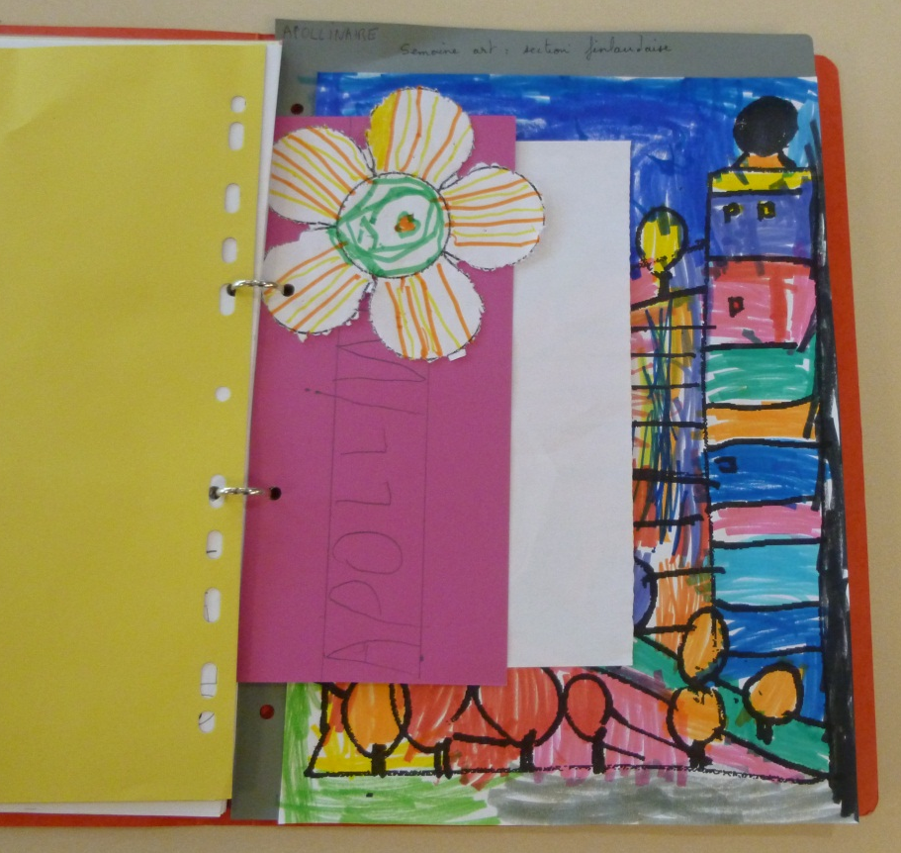
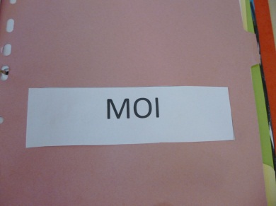
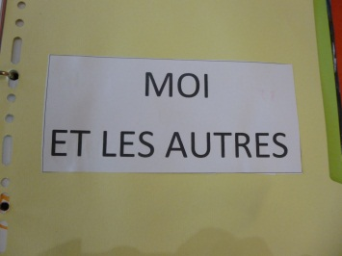
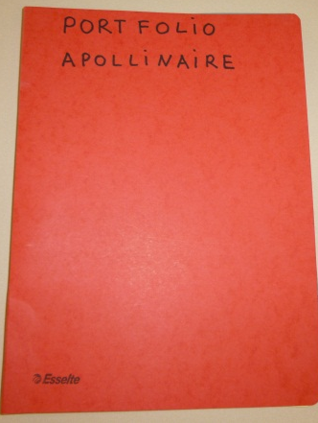
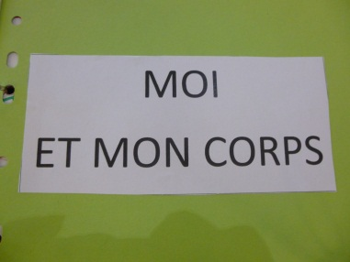
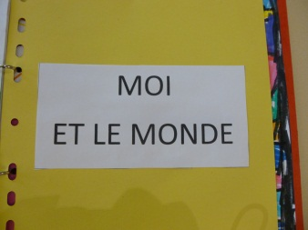
A Portfolio ring binder including the 4 curriculum areas. In this file, the child choose works which he’s proud of, and which are the memory of his progress.

Slide 9
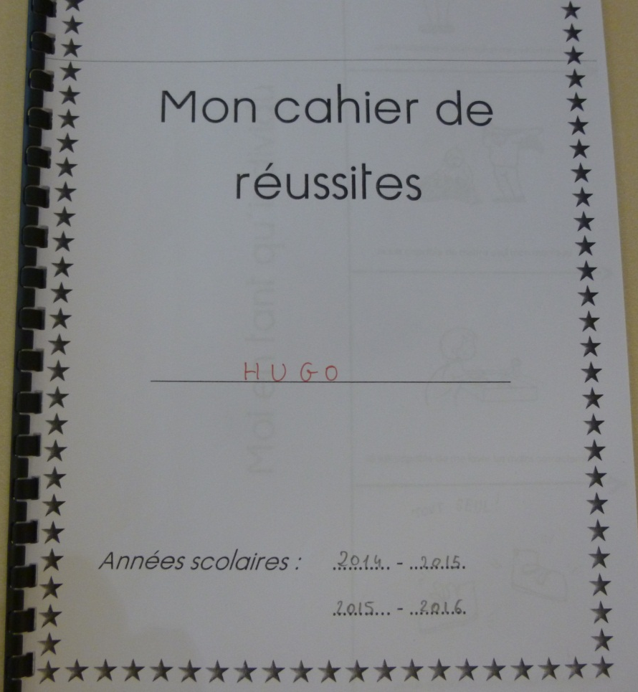
A success notebook linked to the portfolio.

Slide 10
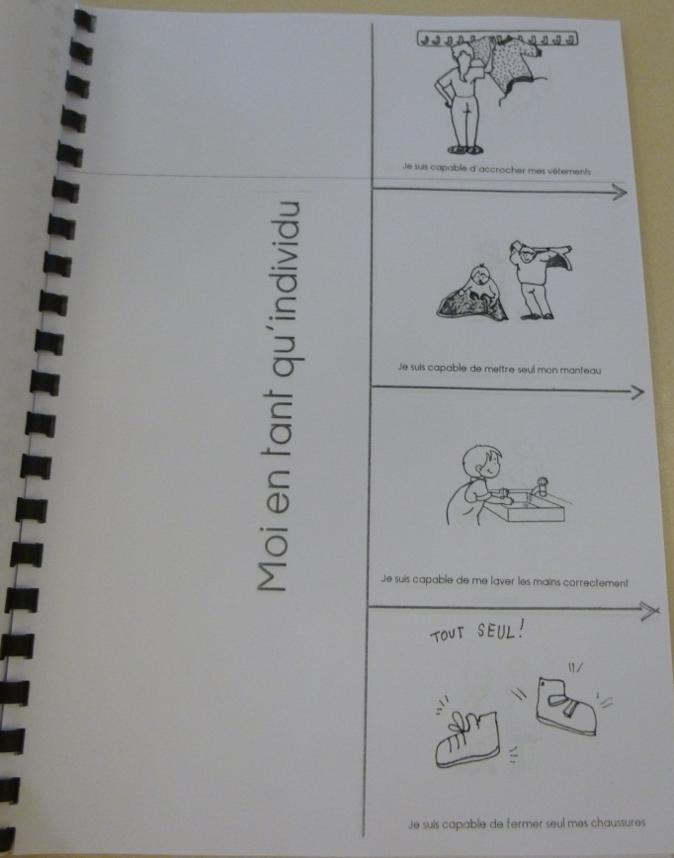
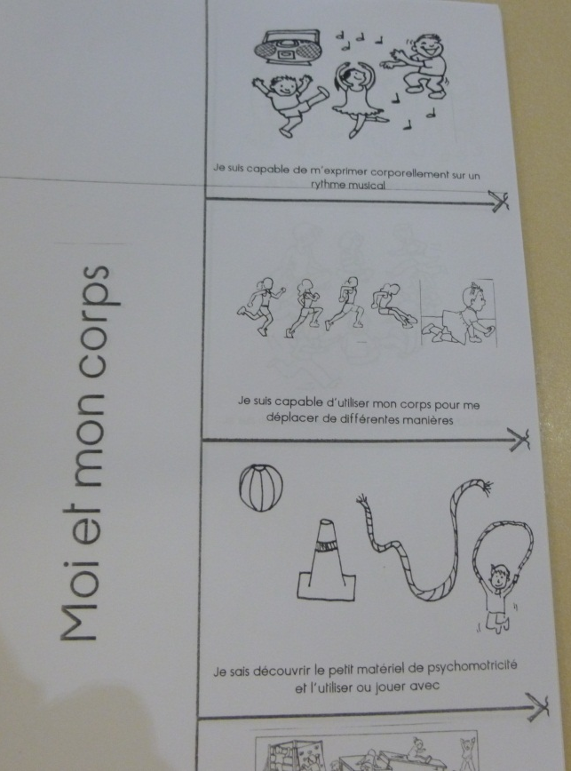
This notebook regroups the different areas: Me as a person, Me and my body, Me and the others, Me and the world. Each area is illustrated by a several pictures illustrating the learnings.
Me as a person
Me and my body

Slide 11
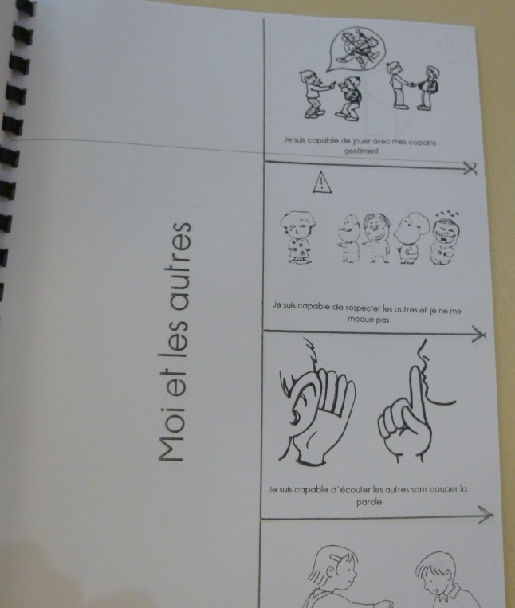
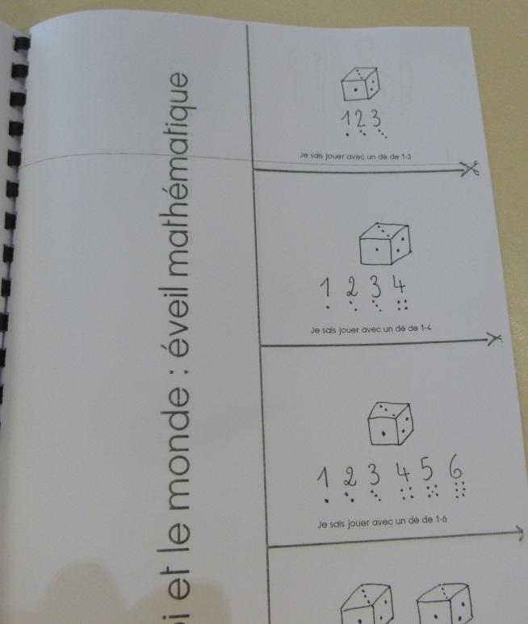
A success notebook linked to the portfolio
Me and the others
Me and the world

Slide 12
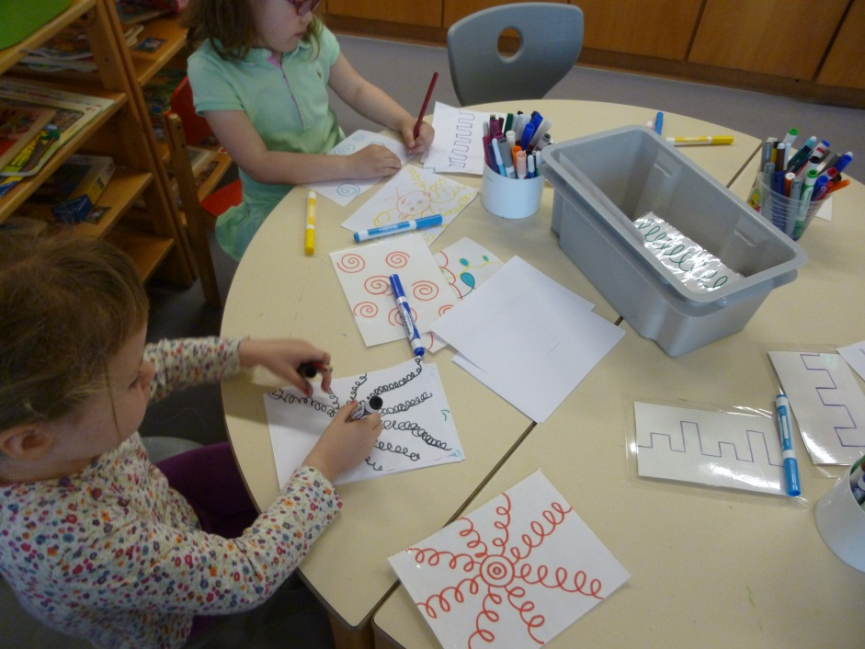
Success notebook and class practice
Children train regularly in the different areas to improve their performances.
For example, they are training to reproduce graphic models which will be proposed in the success notebook.

Slide 13
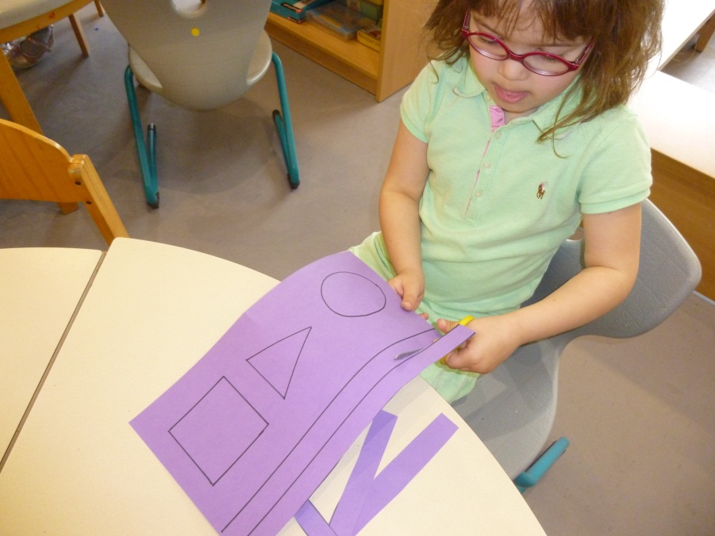
Success notebook and class practice
They choose a success in the notebook and then realize the activity.
« I know how to cut on a line. »

Slide 14
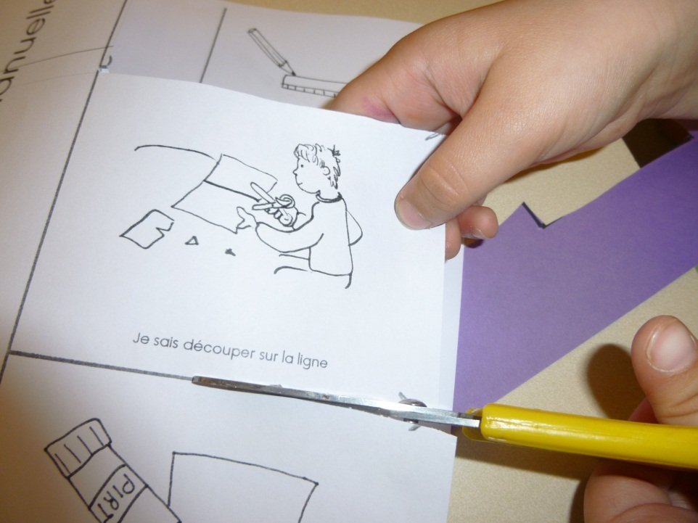
Success notebook and class practice
When the child has succeeded his activity, he cuts out the small picture in his success notebook.

Slide 15
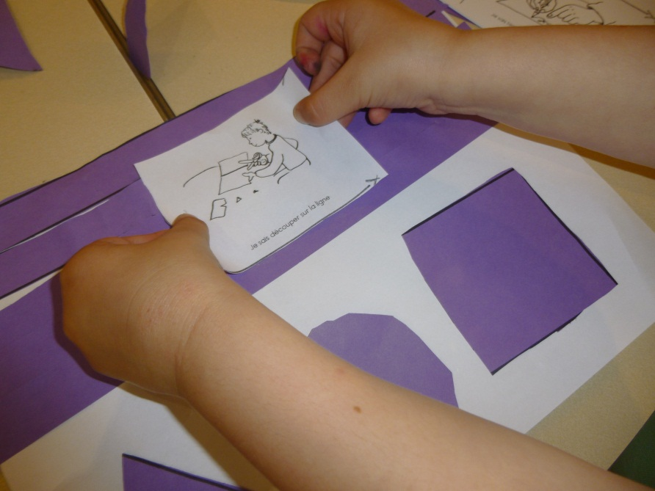
Success notebook and class practice
The child sticks his picture on the work or next to the photo taken by the teacher. This document will be inserted in the Portfolio ring binder.

Slide 16
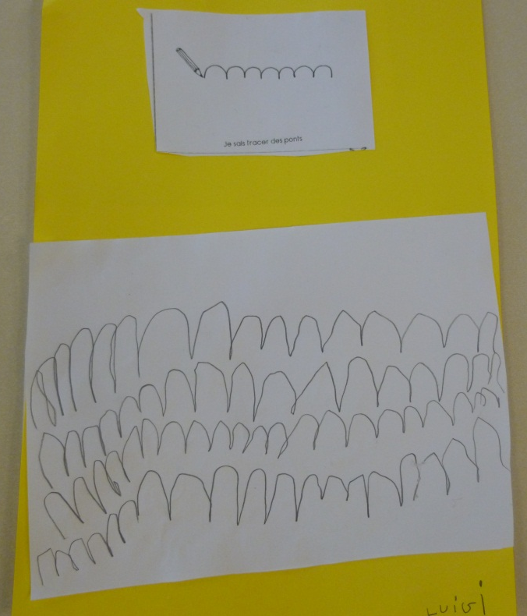
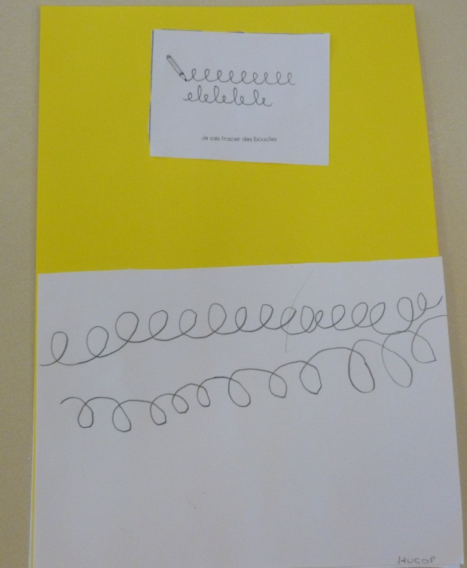
Pictures of some successes
« I know how to draw bridges »
« I know how to draw loops. »

Slide 17
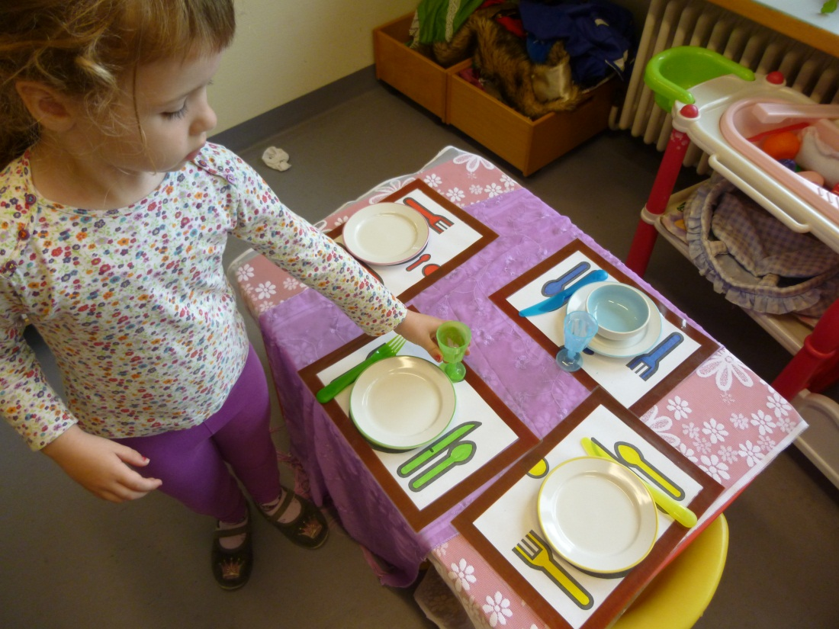
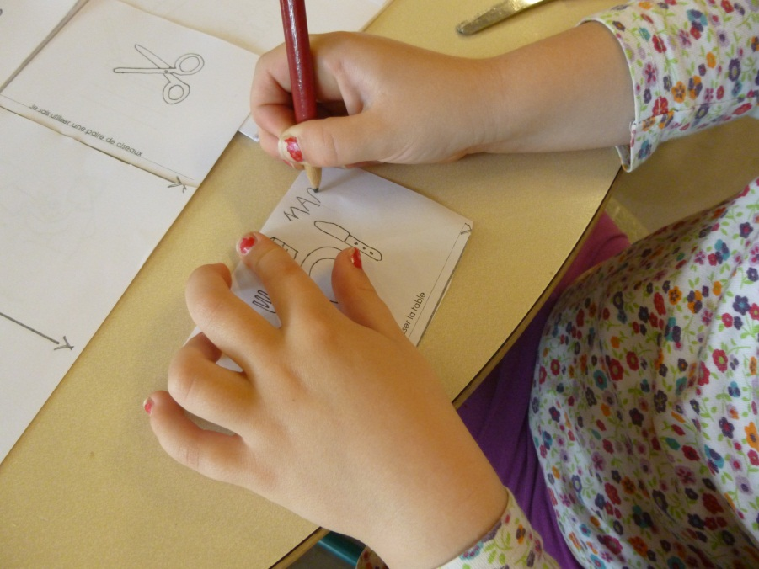
« I know how to set the table. »

Slide 18
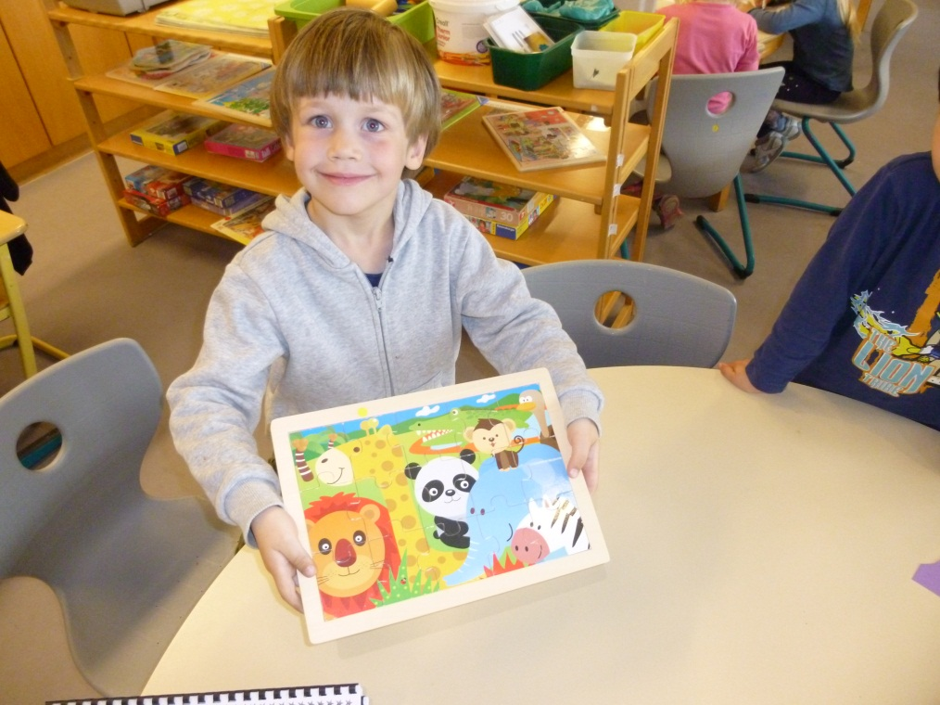
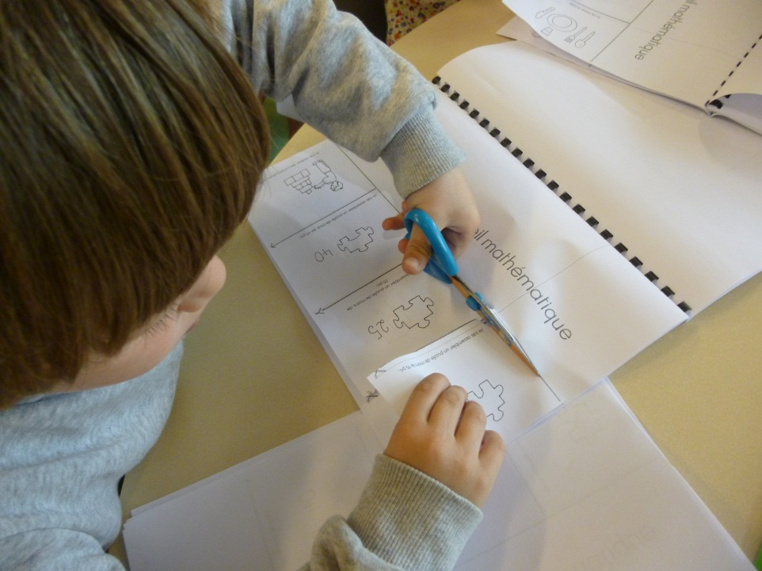
« I know how to assemble a 15 pieces puzzle »

Slide 19
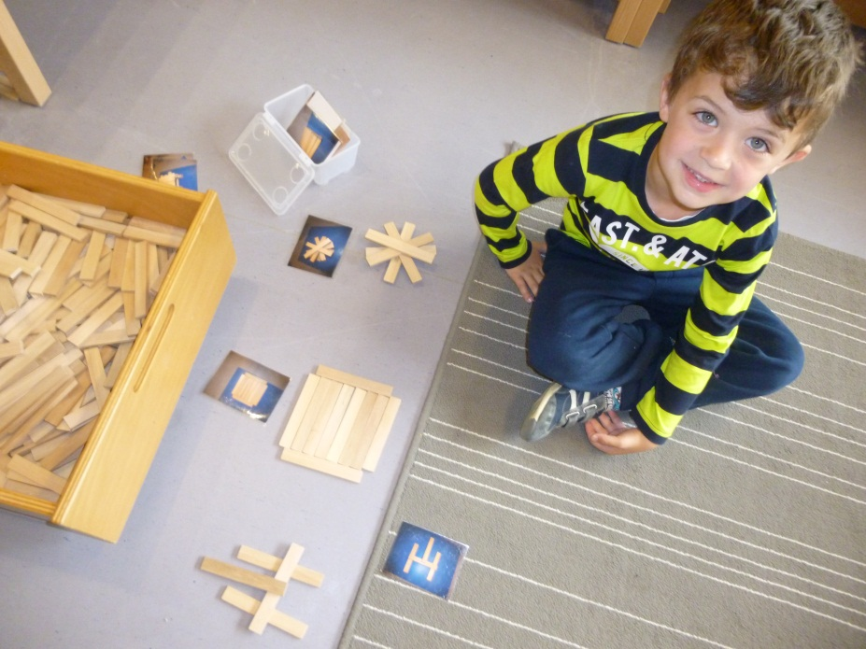
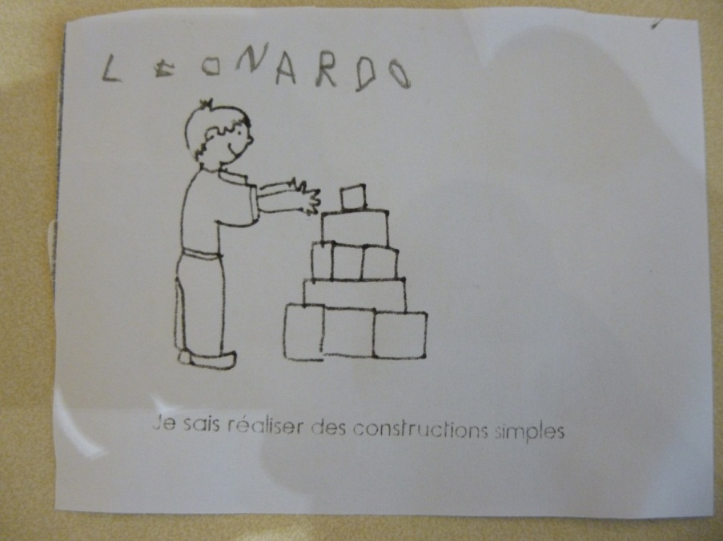
« I know how to build simple constructions. »

Slide 20
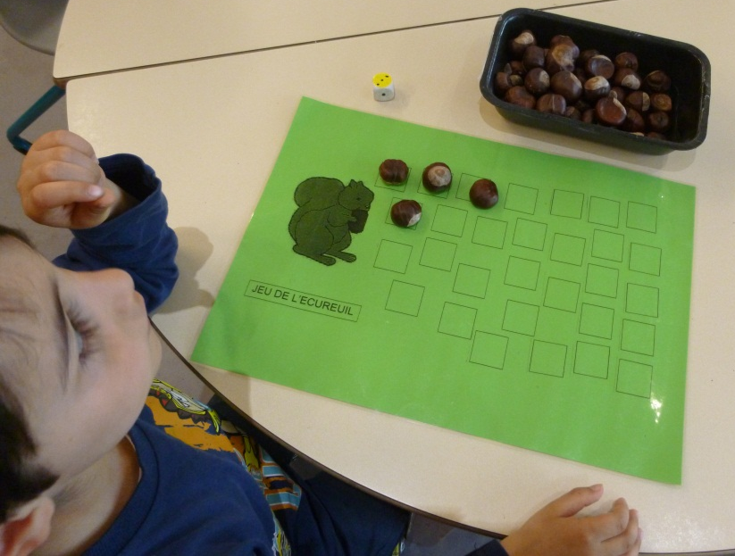
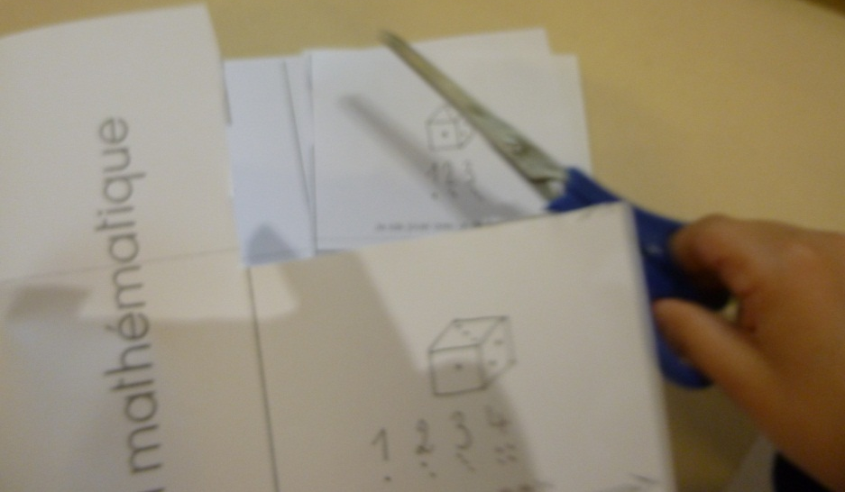
« I know how to play with a dice (1 point to 3 points). »

Slide 21
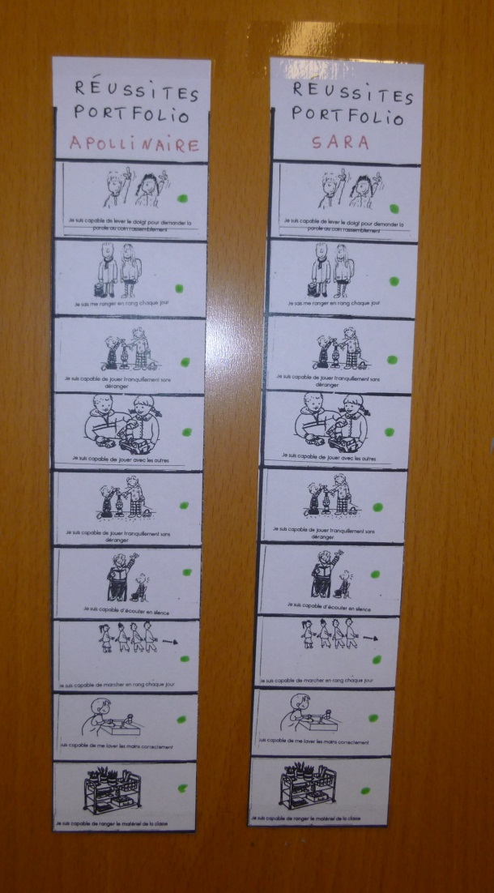
Part 3: Other tools allow to encrich the successes linked to the portfolio
For the skills linked to the « Me and the others » area, stripes representing a series of skills in this area are put up in the classroom. With the child, I do an outcome of his progresses and I mark a green point for each succeeded skill. Each picture will then be cut out and stuck in the portfolio.

Slide 22
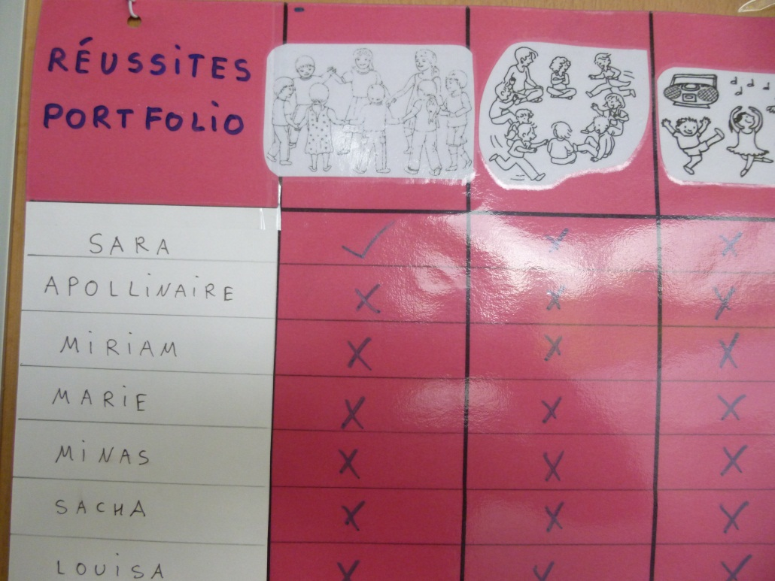
PART 3: Other Tools
For some skills linked to the « Me and my body » area, a table is put up in the gym room, which allows me, with the child, to point the successes in the motor skills specific areas. The successes will be then inserted into the portfolio.

Slide 23
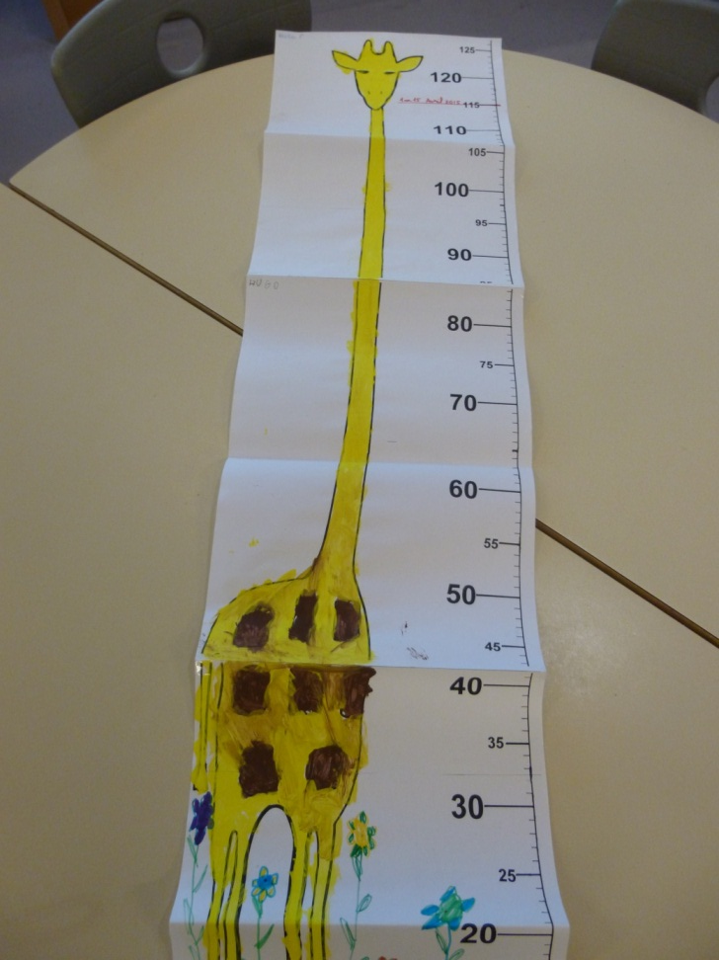
Some other works equally enrich the portfolio
For example, for « Me and my body », the children made a height gauge where their height is indicated. Next year, this height gauge will be re-used.

